Slide 1
Lower Monumental Dam RW Tailscreen Modification Juvenile Lamprey
2013

Slide 2
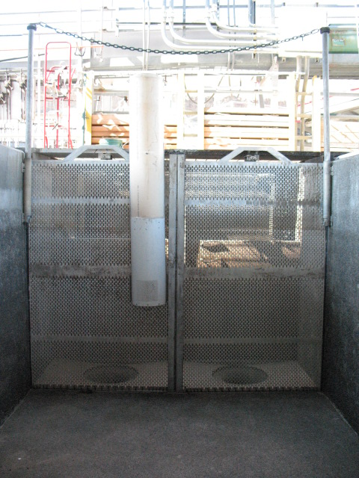
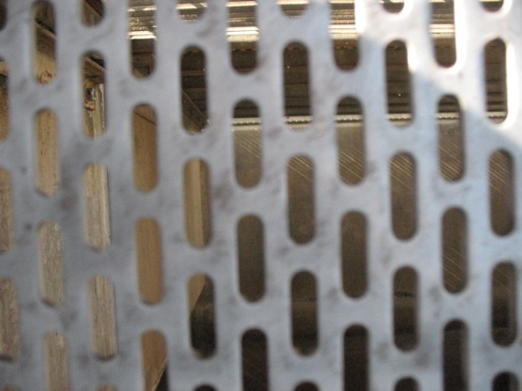
Perforated tailscreens were installed in raceway #2 in 2012
Perforated tailscreens were installed in raceway’s 1, 3, and 4 in 2013
Slot size 5/16” x 1”

Slide 3
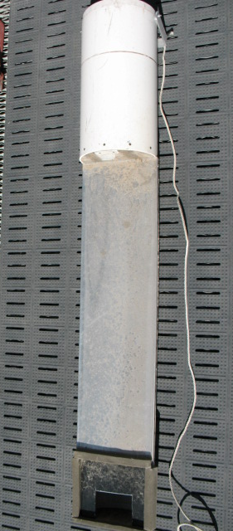
Lamprey were collected from raceways and held in a perforated 5 gallon with continuous flow of
raw water
Lamprey were released
through the lamprey
release tube into raceway
#2
Releases were recoded
with an underwater
camera

